Slide 1
Training 1
Hello world!

Slide 2
Intro to competitive programming

Slide 3
Competitive programming is a mind sport usually held over the Internet or a local network, involving participants trying to program according to provided specifications.

Slide 4
The aim of competitive programming is to write source code of computer programs which are able to solve given problems.
A vast majority of problems appearing in programming contests are mathematical or logical in nature.
Typical such tasks belong to one of the following categories: combinatorics, number theory, graph theory, geometry, string analysis, and data structures.

Slide 5
A, E, I, O, U, M, and T took a test and their scores are {69, 98, 66, 80, 90, 63, 98} respectively.
Who is below the average score?
M, I, A, O
Who scored the highest?
E, T

Slide 6
How many ways are there for me to express $1.20 in coins?
[Coins are of denominations $0.01, $0.05, $0.10, $0.25, $0.50, $1.00]
503 ways
What if we get rid of the useless pennies?
61 ways

Slide 7
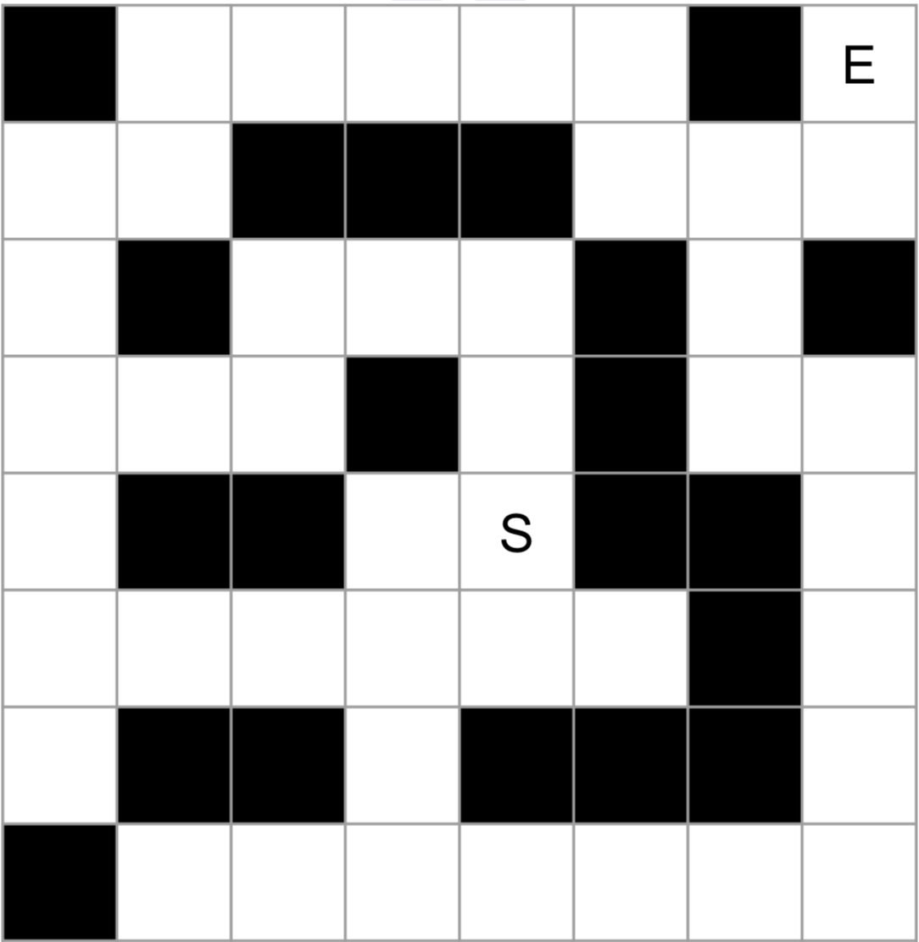
What’s the shortest path from S to E? (Up/down/left/right)

Slide 8
Why competitive?
Competitive Programming
Fixed format/ scoring
Time is limited
CPU/ Memory constrained
Ugly code is fine. Only AC matters.
All algos/ data structures should be memorized
‘Normal’ Programming
Open ended
More flexible time
Spin up more AWS instances
Ugly code = FIRED
Broader, lots of docs/ APIs to read

Slide 9

ACM ICPC
Premier international programming contest, since 1970
Team of 3 students
5 hours, 9-12 problems
Winner of the regional contest goes to the World Finals
Our region is South Central USA
We compete with UT Austin and A&M
Both these universities have their own training programs
We won’t let them beat us again this year!

Slide 10
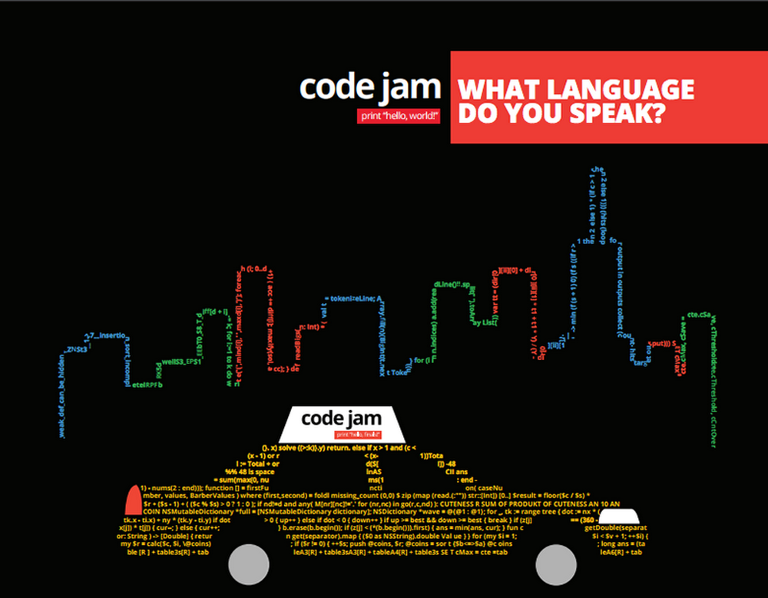
Other competitions
Google Code Jam
Individual contest
4 problems, 2.5 hours
Starts in April
Qualification round lasts for 27 hours - just try it!
Top 1000 participants (Round 2) win a t-shirt
Facebook Hacker Cup
Similar to GCJ
Not running this spring :(

Slide 11
Training Plan

Slide 12
Class Schedule
Every Saturday, 12:30pm to 3:00pm, at Duncan College 113
1 hr - Lecture
1 hr 30 min - Mini-contest, practice your knowledge!
15 min - Brief explanation of questions (solutions released at night)
Weeklong practice contest, released after training
Further practice, strongly encouraged!
Problems will be different
Solutions will be released on Thursday

Slide 13
Club Schedule
Spring 2018 - Introductory and Advanced training
April 7 - Google Code Jam Qualification Round
April 15-30 - Google Code Jam Round 1
May 13 - Google Code Jam Round 2
June 10 - Google Code Jam Round 3
Fall 2018 - Team training
Refreshers and practice sessions
Selection contest for team formation
Held around week 3 of Fall 2018
TBC
After team formation, mini contests will be team contests
Early November - ACM ICPC South Central Regionals

Slide 14
Self Introduction

Slide 15
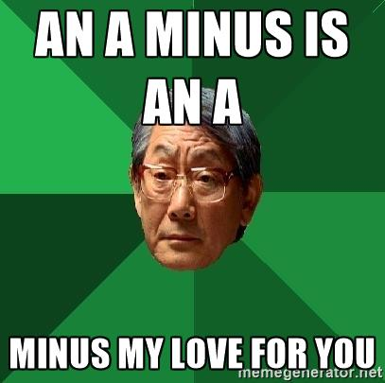
Me!
Freshman :o
Started learning programming / competitive programming in Mid-2015
October - December 2015: Training at National University of Singapore
Our training is based on their training materials
March 2016 - 3rd place at Singapore National Olympiad in Informatics
A- for COMP 140
First time running a training like this

Slide 16
How to do well
Attend lectures!!!
Attempt all practice problems
They will all be different
Practice is the best way to improve problem solving ability + coding ability
Ask questions
NEVER code before solving the problem
Use a piece of paper. Yea. Still better than computers.

Slide 17
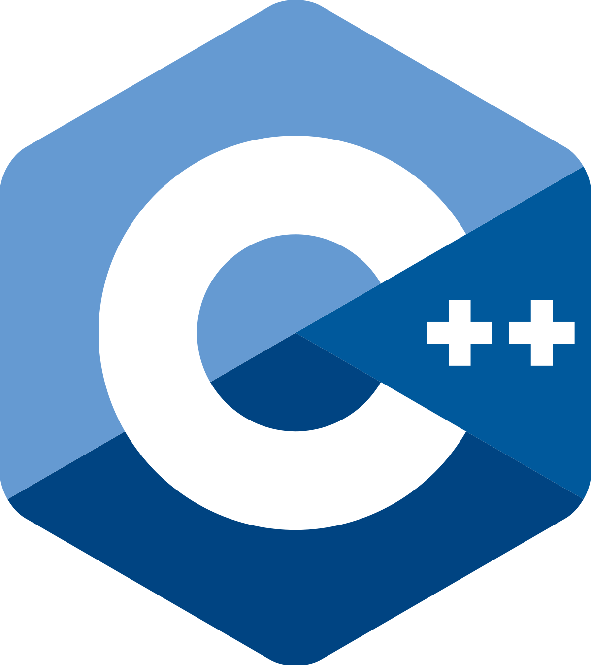
Introduction to ____

Slide 18
Why C++?
C++ is much faster than Python, 10x in many cases
Solutions in C++ that work may not work if written in Python
Why is it faster? It is a simpler language and is compiled, allowing more optimizations
C++ provides us with useful data structures through the Standard Library
ICPC is a team contest; a standardized language allows everyone to work together

Slide 19
Basic C++ Program

Slide 20
Basic C++ Program
#include <iostream>
using namespace std;
int main() {
cout << “Hello World!”;
}

Slide 21
Basic C++ Program
#include <iostream>
using namespace std;
int main() {
cout << “Hello World!”;
}
Input/Output streams library
Contains cout function, which means c-out(put). Basically ‘print’

Slide 22
Basic C++ Program
Makes all functions/objects in the ‘std’ namespace available in the global namespace.
In python, when you import a module, say numeric, its functions are available under the numeric ‘namespace’. (e.g. numeric.Matrix())
In C++, functions like cout will be available as std::cout. ‘using namespace std’ allows us to call cout function directly.
#include <iostream>
using namespace std;
int main() {
cout << “Hello World!”;
}

Slide 23
Basic C++ Program
WITH
#include <iostream>
using namespace std;
int main() {
cout << “Hello World!”;
}
WITHOUT
#include <iostream>
int main() {
std::cout << “Hello World!”;
}
Imagine having to write std:: before all your functions…
IN OTHER WORDS, just include this line whenever you write C++ code

Slide 24
Basic C++ Program
#include <iostream>
using namespace std;
int main() {
cout << “Hello World!”;
}
Unlike Python, where code is executed from the first line, only code in the main function is executed for C++.
The space before main can be used to declare functions and variables.
In most cases, you should never write anything after main.

Slide 25
Basic C++ Program
#include <iostream>
using namespace std;
int main() {
cout << “Hello World!”;
}
Equivalent to print “Hello World!”
Note that cout uses the special syntax ‘<<’.
Also note that every statement in C++ must end with a semicolon

Slide 26
Variables

Slide 27
Variables
C++ is a statically typed language.
This means that for any variable you use, you have to declare its type before assigning a value to it.
The type of a variable cannot change.
For example, if you assign a floating point number to an integer, it will be rounded (truncated) to an integer.

Slide 28
Variables
#include <iostream>
using namespace std;
int main() {
int firstNum = 3;
int secondNum = 5;
int product = firstNum * secondNum;
cout << product;
}
// Prints “15”

Slide 29
Variable types
int: 32 bit integer.
float: 32 bit floating point number, ~7 decimal digits of precision
bool: boolean value, either ‘true’ or ‘false’
string: an array of characters. Strings are denoted by double quotes “ ”
char: a character. Characters are denoted by single quotes ‘ ‘
Note that characters and strings are not interchangeable, though they can be converted (‘cast’) into one another.

Slide 30
Some examples
#include <iostream>
using namespace std;
int main() {
float a = 1.03;
string s = “Potato”;
char c = ‘a’;
}

Slide 31
More examples
#include <iostream>
using namespace std;
int main() {
string s = "abcde";
char c = 'X';
s += c;
cout << s;
}
Prints “abcdeX”
The += notation works like it does in Python:
s += c is equivalent to s = s + c

Slide 32
Important point to note
#include <iostream>
using namespace std;
int main() {
int x;
cout << x;
}
Value of x is undefined
In C++, you have to initialize all values you use.
Otherwise, their value is undefined, and you will get an arbitrary number when attempting to use them.

Slide 33
More variable types
long long: 64 bit integer. int has a range of ~ -2,000,000,000 to 2,000,000,000
If you need more precision, long long has a range of ~ -9,000,000,000,000,000,000 to 9,000,000,000,000,000,000
double: 64 bit floating point number. Double the precision of float (15 decimal places)
long double: 128 bit floating point number. (may be only 64 on some systems)
Use long long/ long double to avoid overflow/ loss of precision for questions involving large numbers

Slide 34
Even more examples
#include <iostream>
using namespace std;
int main() {
long long x = 1e10;
x++;
cout << x;
}
x is 10,000,000,001
Numbers can be expressed in the exponential notation
In addition to ‘+=’, C++ has the ‘++’ operator, which works like ‘+= 1’.
(But there’s a difference!)
This comes in handy when writing loops.

Slide 35
Logic Flow

Slide 36
If / Else statements
#include <iostream>
using namespace std;
int main() {
int x = 10;
if (x < 5) {
cout << “x is small” << endl;
} else if (x == 5) {
cout << “x is 5” << endl;
} else {
cout << “x is large” << endl;
}
}
C++ has a simple if/else structure
Nested series of if/else loops
Note the addition of endl.
This prints the newline character, ‘\n’, after the text.

Slide 37
While loops
A while loop stops when the expression evaluates to False
2 things are happening here:
while (x): in C++, integers can be evaluated/cast to boolean values. Nonzero values = True, zero = False. Loop stops when x is 0.
Here we see the key difference between ‘--’ and ‘-= 1’. ‘-=1’ is applied immediately to x.
On the other hand, when ‘--’ is used in an expression, it is only applied after the expression is evaluated.
After x = 1 is printed, the while loop evaluates ‘x--’.
Since x = 1, ‘x--’ evaluates to true, the loop continues.
x is now 0, and is printed.
The loop terminates.
#include <iostream>
using namespace std;
int main() {
int x = 5;
while (x--) {
cout << x << endl;
}
}
Prints 4, 3, 2, 1, 0
each on a new line

Slide 38
For loops
#include <iostream>
using namespace std;
int main() {
for (int i=0; i<5; i++) {
cout << i << endl;
}
}
Prints 0, 1, 2, 3, 4
each on a new line
In for loops, we define 3 conditions:
The initial condition/ value
The termination condition. If the green expression evaluates to False, the loop stops. (Checked before the loop content runs)
Update value. Can be changed to i+=2 to skip every other number

Slide 39
More fun with loops - Break
#include <iostream>
using namespace std;
int main() {
for (int i=0; i<5; i++) {
if (i == 3) break;
cout << i << endl;
}
}
Prints 0, 1, 2
each on a new line
The break statements stops the loop from running.
Note that code ‘blocks’ with only one statement need not be contained in brackets.

Slide 40
More fun with loops - Continue
#include <iostream>
using namespace std;
int main() {
for (int i=0; i<5; i++) {
if (i == 3) continue;
cout << i << endl;
}
}
Prints 0, 1, 2, 4
each on a new line
The continue statement immediately ends this iteration of the loop and moves again to the start.

Slide 41
Input / Output

Slide 42
Chaining cout
#include <iostream>
using namespace std;
int main() {
cout << “ABC” << “def” << “XYZ” << endl;
}
Prints “ABCdefXYZ”
Notice that the arrows point to ‘cout’, the ‘output stream’.

Slide 43
Input - cin
Multiple variables can be declared in the same line.
cin takes input and assigns them to the variables.
The behavior of cin depends on the type of variable that is receiving input.
cin into a string, for example, will take all the characters before a whitespace character (space, newline, etc.)
Note the arrows point away from the input stream
#include <iostream>
using namespace std;
int main() {
int x, y;
cin >> x >> y;
cout << y << “ “ << x;
}
Input: 10 30
Output: 30 10

Slide 44
Arrays

Slide 45
C++ arrays
C++ arrays can be very different from normal Python arrays. We won’t be concerning ourselves with their complexity yet.
C++ arrays have a fixed size.
Allocate more than you need.
If you exceed the array size, bad things happen
Arrays can only contain elements of a specific type
Similar to uninitialized integers, an uninitialized array will contain undefined / arbitrary numbers
#include <iostream>
using namespace std;
int main() {
int a[100];
for (int i = 0; i < 10; i++) {
a[i] = i;
}
}
Assigns first 10 elements of a to 0-9
Other elements are undefined

Slide 46
Problem solving

Slide 47
Simple problem
John has a bucket of n numbers (n <= 100), and he wants you to calculate their average.
Input format:
n, followed by n integers representing the n numbers.
Output:
The average value, represented by a float

Slide 48
Solution
#include <iostream>
using namespace std;
int main() {
int n, a[100];
cin >> n;
for (int i = 0; i < n; i++) cin >> a[i];
int total = 0;
for (int i = 0; i < n; i++) total += a[i];
double average = (float)total / n;
cout << average;
}

Slide 49
Input
#include <iostream>
using namespace std;
int main() {
int n, a[100];
cin >> n;
for (int i = 0; i < n; i++) cin >> a[i];
int total = 0;
for (int i = 0; i < n; i++) total += a[i];
float average = (float)total / n;
cout << average;
}

Slide 50
Computation
#include <iostream>
using namespace std;
int main() {
int n, a[100];
cin >> n;
for (int i = 0; i < n; i++) cin >> a[i];
int total = 0;
for (int i = 0; i < n; i++) total += a[i];
float average = (float)total / n;
cout << average;
}
(float) converts total from integer to a float, enabling floating point division.

Slide 51
Output
#include <iostream>
using namespace std;
int main() {
int n, a[100];
cin >> n;
for (int i = 0; i < n; i++) cin >> a[i];
int total = 0;
for (int i = 0; i < n; i++) total += a[i];
float average = (float)total / n;
cout << average;
}

Slide 52

Running Code

Slide 53
Running Code in C++
C++ is a compiled language.
Code is compiled into a binary.
The binary can then be executed, not necessarily right after compilation.

Slide 54
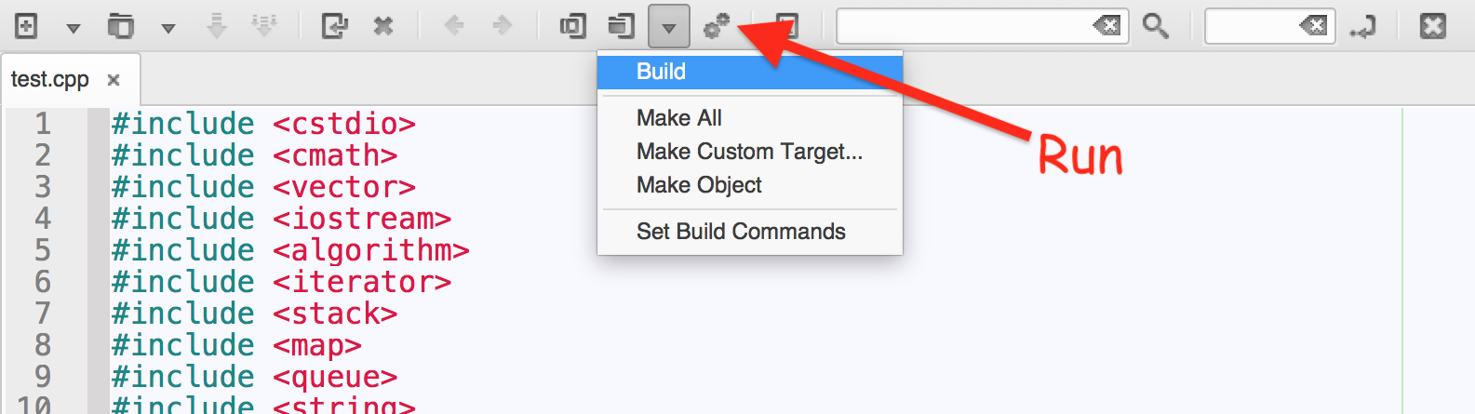
Running code in Geany
Save your file as filename.cpp
Build your file (F9)
Execute (F5)
Type inputs into the terminal, pressing enter to confirm

Slide 55
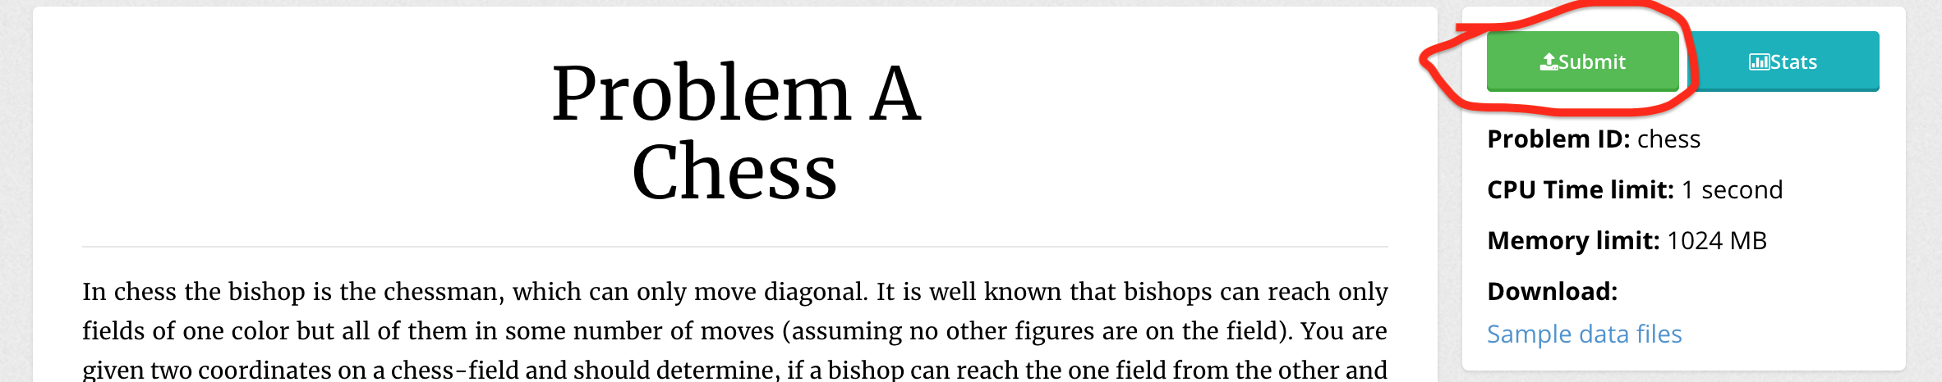
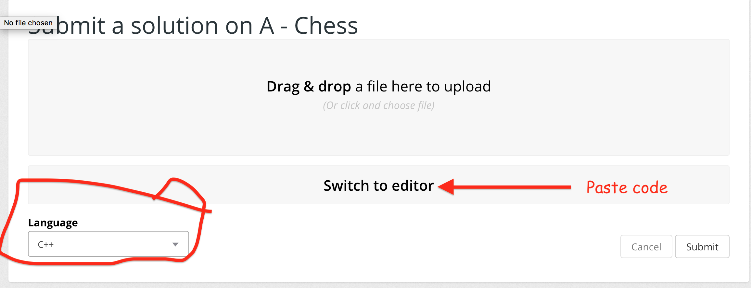
Using Kattis

Slide 56
Mini Contest 1
Link for the contest is posted in the Facebook group
https://www.facebook.com/groups/338023700013099/
Barebones C++ program for your reference:
#include <iostream>
using namespace std;
int main() {
}

Slide 57
Contest Discussion

Slide 58
Hello
Hello World!

Slide 59
Fizzbuzz
Classic problem, just check for cases

Slide 60
Cold-puter Science
Maintain a ‘total’ variable

Slide 61
Line Them Up
Check for increasing and decreasing.
Strings can be compared directly

Slide 62
Guess the Number
Binary Search

Slide 63
DVDs
There’s no sorting needed
Note that you have to remove all DVDs below n.
Then, you have to remove all DVDs below n-1 and above n.
…
Count the number of DVDs not removed: going upwards from the bottom, count n, n-1, n-2… if a dvd is not found, stop counting.

Slide 64
Reversed Binary Numbers
How to convert from integer (x) to binary?
Use a string, s, to store binary.
While x is not zero,
s = x%2 + s;
x /= 2;
Reverse a string using reverse(s.begin(), s.end()). #include <algorithm>.

Slide 65
Digit Sum
Digit Sum
We can count the digits in each position (ones, tens, hundreds, etc.) individually.
For example, tens: 0, 0, 0, 0, 0, 0, 0, 0, 0, 0, 1, 1, 1, 1, ...
Notice that the numbers repeat.
Count carefully.

Slide 66
You can continue trying the problems. Solutions will be posted tonight.
A homework practice problem set will also be posted.
Please fill up the survey in the Facebook group

